Slide 1
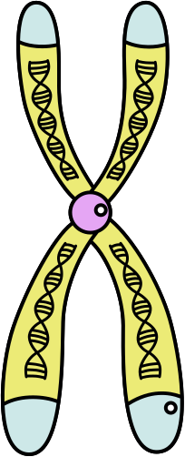













GENE ERRORS & EVOLUTION
Genetic Mutations and Adaptations Across Four Asian Countries
PRESENTATION BY
YOGYA MADAHAR (TEAM LEADER)
AAYAN SIDDIQI
ADITYA SHARMA
ANWAR AFRIDI
MICHAEL OJI
DEPARTMENT OF BIOTECHNOLOGY ENGINEERING

Slide 2




CATALOGUE
1
Genetic Mutations and Factors Affecting it
Mutations Within and Among Four Different Asian Countries
Summary and Discussion
2
3

Slide 3


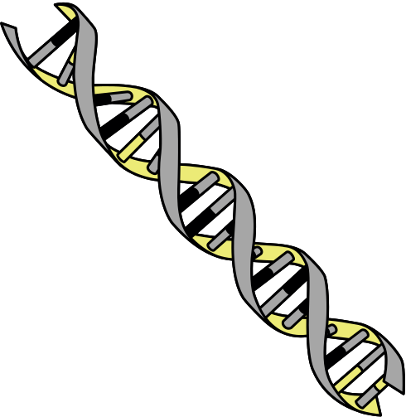




LEARNING OBJECTIVES
  Understanding mutations throughout years in India, Pakistan, Indonesia and Korea.
  Understanding the scientific significance and grasp its role in various fields of STEM.

Slide 4
UNDERSTANDING THE DATABASE
Our presentation and work is mostly influenced by ‘The Genome Asia 100k Project’ enabling genetic discovery across Asia. the article was published online on 4th December,2019. Let us review in brief what was presented in the research paper.
The GenomeAsia 100K Project is an international genomic initiative aimed at sequencing 100,000 individuals to create the most comprehensive map of Asia’s genetic diversity. Its pilot study, published in December 2019, sequenced 1,739 genomes from 219 population groups across 64 Asian countries. This was significant because Asian populations which make up over 60% of the world were historically underrepresented in global genomic databases, making it difficult to accurately interpret genetic variants or apply precision medicine in these regions.
The project uncovered thousands of previously unreported or misclassified variants and revealed strong population structure within Asia, including major genetic differences among South, East, and Southeast Asians. Many variant frequencies differed sharply from those reported in European-based datasets, showing why Asia-specific references are essential. By capturing both common and rare variants, especially in small or isolated groups, the project improves the reliability of disease-gene mapping, risk prediction, and genotype imputation for Asian populations.

Slide 5

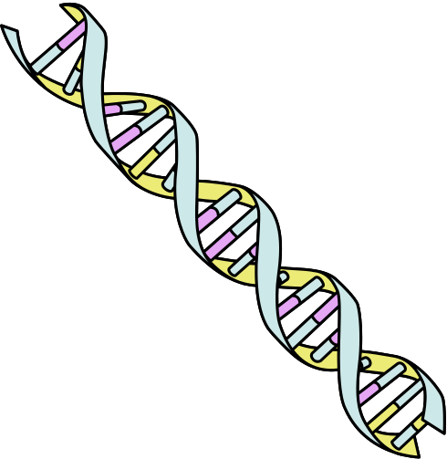


INTRODUCING MUTATIONS
Hugo De Vries is often regarded as the ‘Father of mutation’ It is true that the mutations are nature’s handwriting in the book of evolution; however question is what exactly is gene code and what are mutations?
In simple words genetic code is the set of rules used to translate the sequence of DNA and RNA into proteins. A mutation refers to the change in the particular sequence caused by deletion or addition of nucleoids. Interestingly these mutations can either be spontaneous or evolutionary. While some mutations cause devastating disorders, others are the very engine of evolution, generating the diversity and complexity essential for life's innovation.

Slide 6

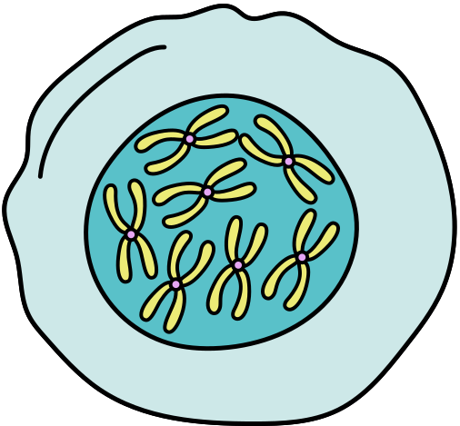
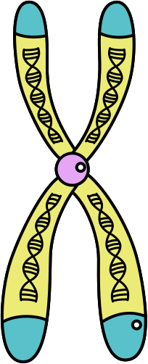


ZOOMING FURTHER INTO FACTORS AFFECTING MUTATIONS
Due to physical, biological, chemical, and environmental factors the normal structure or copying of DNA. When DNA is harmed or copied incorrectly, the changes can become permanent, resulting in mutations.
1
2
3
4
X-rays, gamma rays, and UV light damage DNA by breaking strands or altering bases. | Mustard gas, nitrous acid, and alkylating agents modify DNA bases, causing incorrect pairing. | Viruses, bacteria, and transposons disrupt DNA by inserting their genetic material or causing internal DNA damage. | Pollution, smoke, pesticides, and heavy metals increase long-term DNA stress, leading to mutations.
PHYSICAL
CHEMICAL
BIOLOGICAL
ENVIRONMENTAL
BY: BARBARA MCCLINTOCK
CLASSIFIED BY: BRUCE AMES
BY: HERMANN J. MULLER
BY: CHARLOTTE AUERBACH

Slide 7



UNDERSTANDING GENES WITHIN BORDERS
Science builds its truth through patterns hidden in data. While borders define nations, genes define the shared story of life. Every nation carries a genetic fingerprint as unique as its culture. We will look at four countries (Korea, Pakistan, Indonesia and India) along with their genetic pool. With studies and reliable database, we shall also go through the mutations in accordance with factors affecting it.
The countries will be discussed in increasing order of land mass so as to understand more clearly how a larger geographical area ensures diversity.

Slide 8
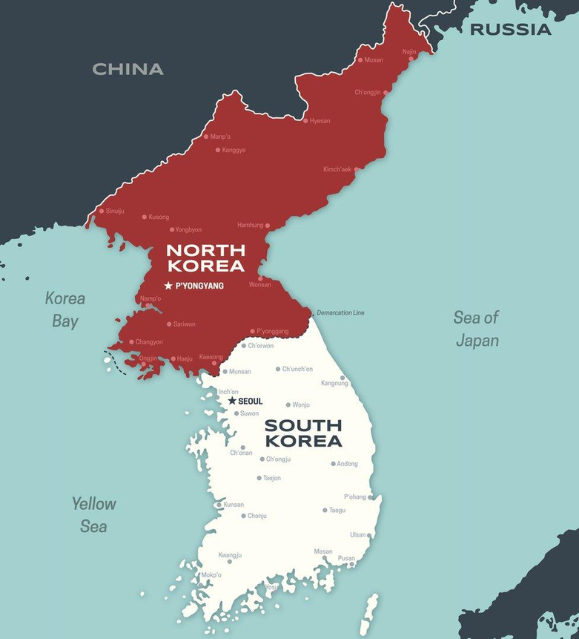


KOREAN GENETIC POOL
GENETIC MODIFICATION
Korea even if is a small, homogenous country but if you observe closely, there are actually some minor differences in genes between people from the north, south, and the islands like Jeju.
1.Jeju Island (Haenyeo) Genetic and Physiological Adaptation
On Jeju Island, female divers known as Haenyeo traditionally perform repeated cold-water diving. Studies report a gene variant linked to cold-tolerance physiology found in ~33% of Jeju residents, compared to ~7% among mainland women. Physiological tests also show stronger heart-rate reduction during cold water exposure (~18.8 beats/min) than non-diving island residents (~12.6 beats/min). This suggests an advantageous adaptation contributing to improved performance in cold, breath-holding conditions.
2.Alcohol Flushing (ALDH2 Gene)
Koreans tend to develop a red face, nausea, or racing heartbeats after alcohol consumption, due to this gene. It’s quite common in here. Basically, the body breaks down alcohol slower and that’s why people experience such symptoms. It’s interesting because since developed, people avoid drinking too much or too often thus working as a biological warning. However, people with this gene deficiency are at a high risk of esophageal, liver and stomach cancer.
3.MYBPC3 Gene (Heart Health)
When this gene mutates, the heart muscle can become extremely thick or weak, causing diseases like Hypertrophic Cardiomyopathy (HCM) that is where the heart walls grow abnormally and make it harder for the heart to pump blood. In Koreans, changes in the MYBPC3 gene are very common and are one of the main reasons for heart muscle disease.
These changes can run in families, and some people may have mild symptoms while others may have serious heart problems or even sudden heart failure.

Slide 9

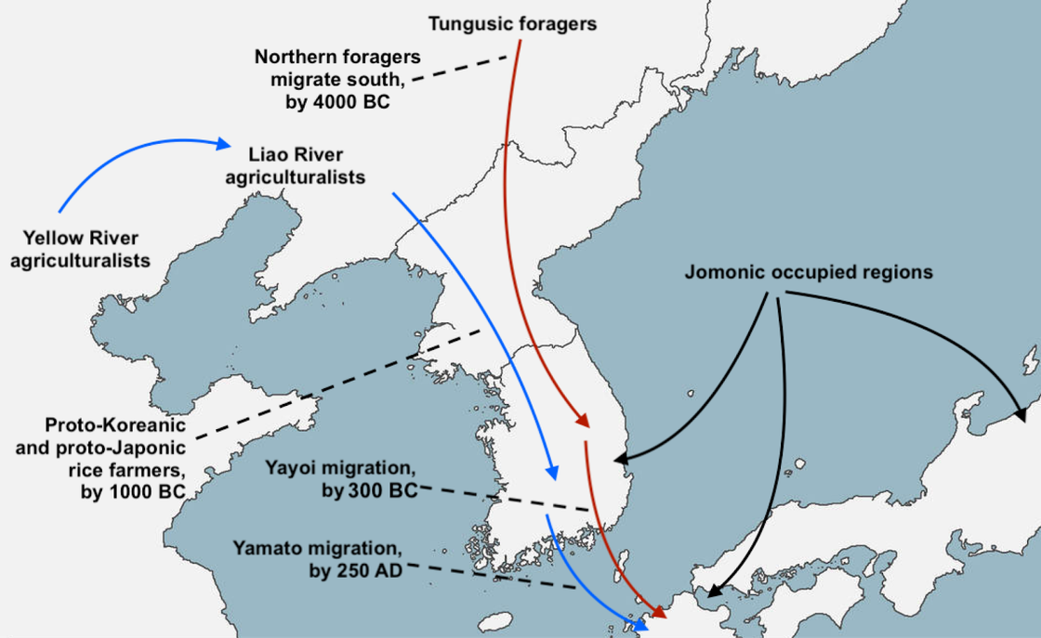



GENETIC MODIFICATIONS IN KOREA
These differences come from old migrations, trade, and just how people lived in various areas for thousands of years and modified their bodies internally to adapt to these places.

Slide 10


SIGNIFICANCE OF OUR STUDIES
Studying genetic mutations in Korean populations is significant because many variants found in this dataset were absent or misclassified in global databases dominated by European genomes. For example, the project identified novel pathogenic and benign variants that corrected earlier misinterpretations, and it uncovered population-specific allele frequencies that improve disease-risk analysis and rare-variant filtering for Asian groups.
This research directly strengthens precision medicine. The GA100K dataset showed major inter-population differences in medically relevant genes such as variants affecting drug metabolism, cancer susceptibility, and inherited disorders

Slide 11

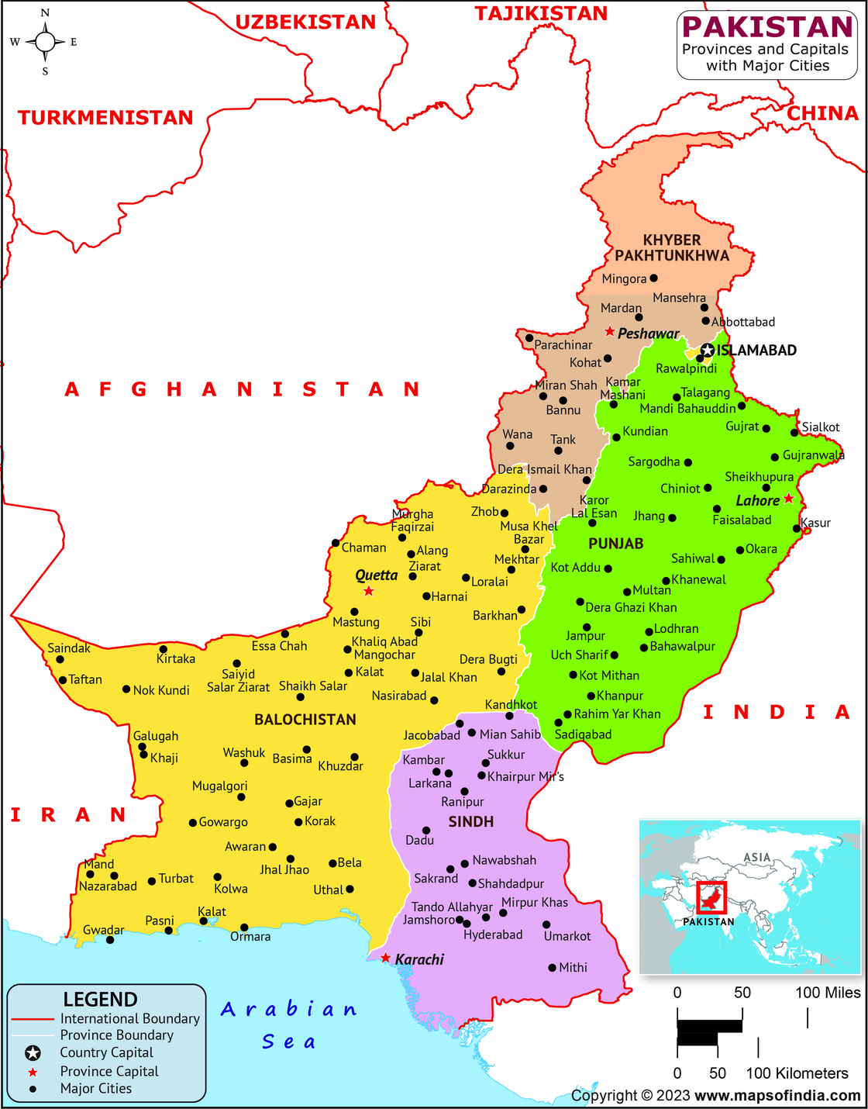

PAKISTANI GENETIC POOL
Mutated genes and recessive disorders are unusually common in Pakistan because of the consistently high rate of consanguineous marriages, especially cousin marriages, which has remained culturally prevalent since the country’s formation in 1947. When relatives marry, they share a larger portion of the same genetic variants, including harmful recessive mutations, making it much more likely for children to inherit two copies of a defective gene and develop a genetic disorder. Over generations, this has led to the persistence and accumulation of founder mutations within specific families, tribes, and regions. Limited genetic screening, low public awareness, and restricted access to reproductive counseling further reinforce the continued spread of recessive conditions in the population.

Slide 12

2. Primary Microcephaly
It is significantly more common in Pakistan compared to Western countries because of the high frequency of autosomal recessive mutations in genes like ASPM and WDR62, which have been repeatedly identified in Pakistani families. Consanguineous marriages amplify the chance of inheriting identical mutated genes, making this condition particularly visible in rural and tribal regions. Children with primary microcephaly often present with smaller head size at birth, developmental delay, and intellectual disability, and many cases are linked to well-documented founder mutations unique to Pakistani populations.
3.Cystic Fibrosis (CF)
Although traditionally viewed as a “Western” disease, CF is increasingly recognized in Pakistan due to mutations in the CFTR gene, especially the common delta-F508 mutation. Because symptoms like chronic cough, malnutrition, and recurrent chest infections overlap with tuberculosis and other respiratory diseases, CF is frequently misdiagnosed or identified late. Limited availability of newborn screening and genetic testing means many cases go unrecorded, but increasing awareness shows that CF is more prevalent in Pakistan than previously believed, especially in families with a history of repeated child morbidity due to recessive mutations.
PAKISTANI GENE MODIFICATIONS
  Muscular Dystrophies (e.g., Duchenne Muscular Dystrophy — DMD)
DMD in Pakistan is often underdiagnosed but relatively common due to high rates of X-linked recessive mutations passing silently through female carriers in consanguineous families. Boys affected by DMD typically show muscle weakness, delayed walking, and difficulty climbing stairs, but due to limited awareness and poor access to genetic testing, diagnosis often occurs late. Founder mutations within certain tribes and a lack of routine carrier screening contribute to the repeated transmission of the DMD gene mutation across generations.

Slide 13
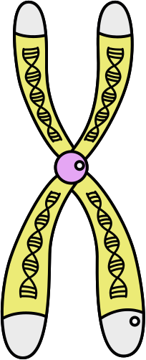







IMPLICATIONS OF FINDINGS
Learning about genetic mutations in Pakistan is important because the country has one of the highest rates of consanguineous marriages, which increases the expression of recessive disorders and allows harmful mutations to persist across generations. Understanding these mutations helps improve early diagnosis, guide genetic counseling, and prevent the repeated transmission of severe hereditary diseases. Although it may sound like a textbook example of a population affected by inbreeding, the reality is more complex—social, cultural, and historical factors shape these genetic patterns, and studying them is essential for better healthcare planning and community awareness.

Slide 14

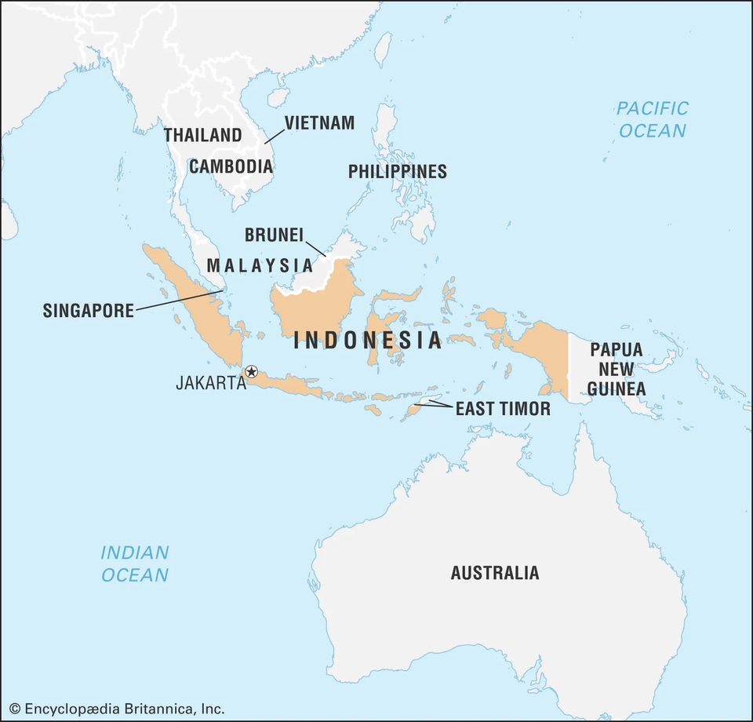
INDONESIAN GENETIC POOL
Indonesia’s gene pool includes some of the oldest human lineages outside Africa, with eastern groups carrying high levels of Denisovan-related DNA. Many populations show unique local adaptations, shaped by rainforest, maritime, and high-pathogen environments. Several islands have rare founder mutations, and the genetic differences between Indonesian groups are so large that two communities within Indonesia can be more distinct than entire continental populations elsewhere
There is great variety in the Indonesian gene pool because the country sits at a major crossroads of ancient human migration and consists of thousands of islands that kept populations partially isolated for long periods. Waves of Austronesian, Papuan, Asian, Middle Eastern, and later European ancestry mixed over thousands of years, while island-by-island separation created unique genetic signatures. This combination of migration, isolation, and cultural exchange led to one of the most diverse genetic landscapes in the world.

Slide 15
2. Physiological and Genetic Adaptations to Diving in Sea Nomads
The Bajau people have practiced diving by holding their breath for thousands of years. They can dive to 70 meters without using any scuba equipment. Researchers have found that their spleens are 50% bigger than their non-diving neighbor, the saluan people. The larger spleen holds oxygen-rich blood and releases it when diving. The BDKRB2 gene mutation improves blood flow during dives, and the PDE10A gene mutation makes their spleen grow larger.
3. Genome-wide DNA methylation and gene expression patterns reflect genetic ancestry and environmental differences across the Indonesian archipelago
Genes from Western Indonesia are more closely related to Asia, with genes similar to mainland Asia. Genes in central Indonesia, especially from Sumba, have mixed genes from Asia and Papua. Lastly, people in eastern Indonesia have more Papuan-like genes. These genes are found in their immune genes
INDONESIAN GENE MODIFICATIONS
1.Influence of Single Nucleotide Polymorphism of ENPP1 and ADIPOQ on Insulin Resistance and Obesity
An individual with the Q allele had a 6.6× higher risk of insulin resistance among obese subjects compared to non-carriers. While the ENPP1 gene effect is universal, it's just more noticeable in Javanese because of their genetics and lifestyle.

Slide 16


RESEARCH RELEVANCE
The Indonesian diversity has produced rare and unique genetic variants that help scientists understand human evolution, disease mechanisms, and how populations adapt to extreme environments such as rainforests and high-pathogen regions. Indonesia also carries high levels of Denisovan ancestry, offering insights into ancient human interbreeding and its effects on immunity and physiology. Overall, its genetic uniqueness makes Indonesia a key region for discovering medically relevant mutations and expanding global precision-medicine research.

Slide 17
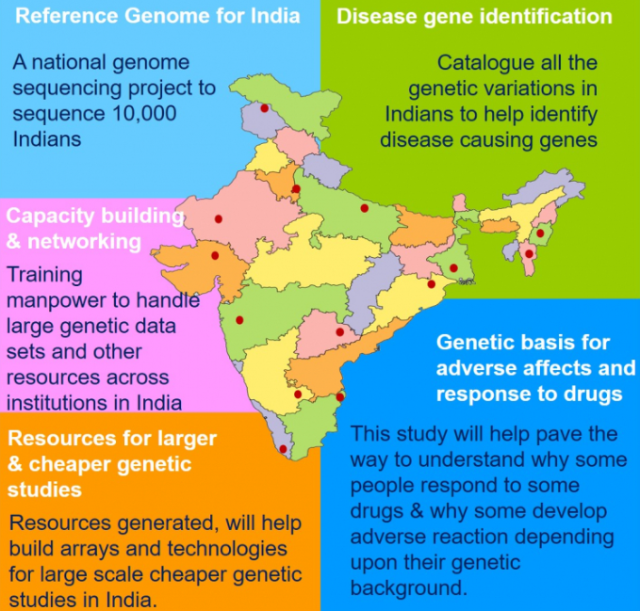

INDIAN GENE POOL
We all do know that India is the most populated and is also the 7th largest country. It is very obvious to note its extensive diversity and rich gene pool. India is not just a country but a case study in itself. It is an epitome of gene diversity among people of a same country.

Slide 18


INDIAN GENE ADAPTATION
  Lactase Persistence (Milk Digestion)
Historical reliance on dairy farming in the north and west led to natural selection favouring lactase persistence. Populations in south have low lactase persistence may experience lactose intolerance, leading to gastrointestinal discomfort when consuming dairy products.
2. MYBPC3 Deletion (Cardiomyopathy)
Mutation likely originated in India about 33,000 years ago and prevalence is high in general Indian population Increased risk of sudden cardiac death due to inherited cardiomyopathies. The clear reason for this mutation is still unknown.
3.CYP2C19 and CYP2D6; liver enzymes metabolizing drugs
People with “poor metabolizer” alleles may need dose adjustments; for example, clopidogrel effectiveness depends on CYP2C19; isoniazid toxicity relates to NAT2 slow acetylators. Risk of adverse drug reactions or ineffective therapy if genotype not considered. Indian subpopulations show substantial variation in CYP and NAT2 allele frequencies; slow NAT2 acetylator genotypes are common (>~50% slow in many Indian cohorts), meaning higher risk of isoniazid toxicity without dose adjustments.
Two people from different Indian states can be genetically more different from each other than many Europeans are from East Asians!

Slide 19

CONSEQUENCES OF OUR STUDIES
India has one of the richest and most diverse genetic structures in the world, shaped by thousands of years of migrations, endogamy, and regional separation. This diversity carries many population-specific mutations that influence how diseases appear, how people respond to medicines, and how certain hereditary disorders are passed on. Studying the Indian gene pool helps improve precision medicine, early diagnosis, genetic counseling, and public-health planning, ensuring that treatments and medical research reflect the unique genetic makeup of Indian communities rather than relying on Western genetic data.

Slide 20
CONSTRUCTIVE COMPARISON WITHIN COUNTRIES
Dividing the four into two separate groups of similar countries we shall now make a constructive comparison between them further elaborating why Indians and Pakistani look so much alike while Koreans and Indonesians have an undeniable closeness
KOREA-INDONESIA
INDIA-PAKISTAN
  Both of these countries share east Asian ancestry because of it’s geographical position.
  This group as a whole spans a wide genetic range but still clusters more with East/Southeast Asians overall.
  Both of the countries share south Asian ancestry because of both geographical positioning and common history
  High genetic diversity within and between subpopulations, due to long demographic history, caste/tribe structure, endogamy and migrations,

Slide 21
SCIENTIFIC SIGNIFICANCE
After extensive briefing on gene pool of four countries, the question might still linger; “Why should we study about genetics of these specific countries?” Well the answer to it is below
WHY THESE SPECIFIC COUNTRIES
HOW IT MIGHT BE REVOLUTIONARY
  They represent four major human migration corridors across Asia.
  They allow detection of selection pressures unique to different climates.
  They improve reference panels for AI-driven genomic models.
  They help identify deep-time population splits and hidden ancestry.
  Promote sustainable agricultural practices that incorporate GMOs responsibly, preserving biodiversity and ecosystem health.
  It can accelerate the discovery of new disease-causing variants and protective alleles.
  It can reveal how modern lifestyle and climate change are reshaping human genes.
  It can help build the world’s most comprehensive Asian genomic reference map.
  It can uncover hidden histories of human migration.
  Implement policies to ensure that the benefits of GMOs, such as increased crop yields and nutritional content, reach vulnerable populations.

Slide 22



SUMMARY AND DISCUSSIONS
CONCLUSION AND FINAL WORDS
POINTS TO PONDER
The genetic landscapes of India, Pakistan, Korea, and Indonesia reveal some of the deepest, most diverse, and evolutionarily significant lineages in Asia. Studying them together uncovers how ancient migrations, isolation, and environmental pressures shaped human biology and why modern medicine must be grounded in global, not Western only, genetic data. Continued research on these regions has the potential to revolutionize precision healthcare, evolutionary science, and pandemic preparedness, making them indispensable to the future of genomic research.
  How much of modern medical research is limited because Asian genomes are underrepresented in global datasets?
  Could studying Asian gene pools in depth rewrite parts of human evolutionary history?
  Could unique mutations found in Indonesia or South Asia lead to new treatments or drug discoveries?
  How should governments handle genetic data while maintaining privacy and preventing misuse?

Slide 23
RESOURCES AND ACKNOWLEDGEMENTS
I would like to thank our professor, and supervisor for guiding us through this exciting yet informative journey. Further i would also like to express my gratitude towards my capable teammates. It was exciting working with them all, everyone was really hardworking and surprisingly together we discussed so much about each other’s countries. It felt like experiencing another culture through lenses of science!

Slide 24



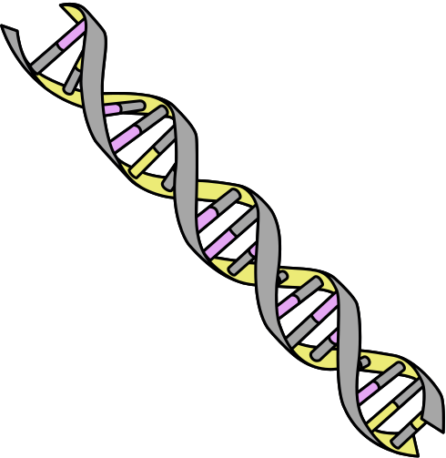


THANK YOU

